Slide 1

FSHARPING GDG Pardubice
Úvod do světa F# (pohledem C# vývojáře)
Roman Provazník
@dzoukr
www.fsharping.cz
@fsharping

Slide 2



Slide 3


Slide 4
www.fsharping.cz

Slide 5

F#

Slide 6


Don Syme

Slide 7
Multi-paradigm
Statically typed
OCaml syntax

Slide 8




Slide 9


F#
C#

Slide 10




Slide 11




Slide 12



Community

Slide 14
The Power of F#

Slide 15
Type inference

Slide 16


Slide 17
Immutability

Slide 18
Immutability is overrated,
but no one will change it

Slide 19
Easy to test

Slide 20
Hard to screw

Slide 21
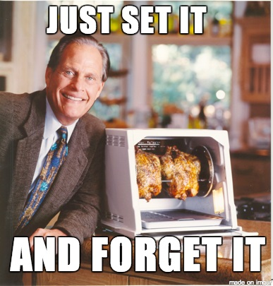

Slide 22
No NULL

Slide 23
Clean code

Slide 24
C#
{{{{{{{{;;;code;;;; }}}}}}}}

Slide 25
F#
code

Slide 26
Less code = Less noise

Slide 27
Less code = Less names

Slide 28
StatelessDataSourceRollbackFactory
AbstractDefaultJavaModelProxy
InternalNamespaceSelectionSingleton

Slide 29
189 projects in solution
9350+ classes
1140 TODOs in code

Slide 30


Slide 31
Naming is HARD

Slide 32
The length of a name should be related to the length of scope

Slide 33
Anonymous functions

Slide 34

Combine all paradigms!

Slide 35
OOP + FP = faster learn

Slide 36
REPL

Slide 37
Read-Evaluate-Print Loop

Slide 38
Use debugger only for bugs

Slide 39
Faster development

Slide 40


Slide 41
$$$

Slide 42
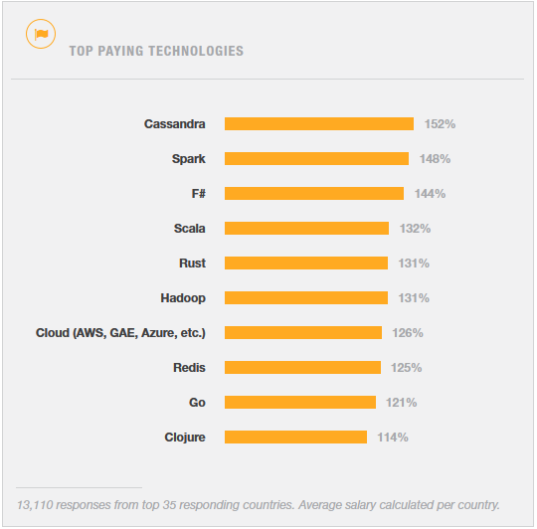
http://stackoverflow.com/research/developer-survey-2015

Slide 43
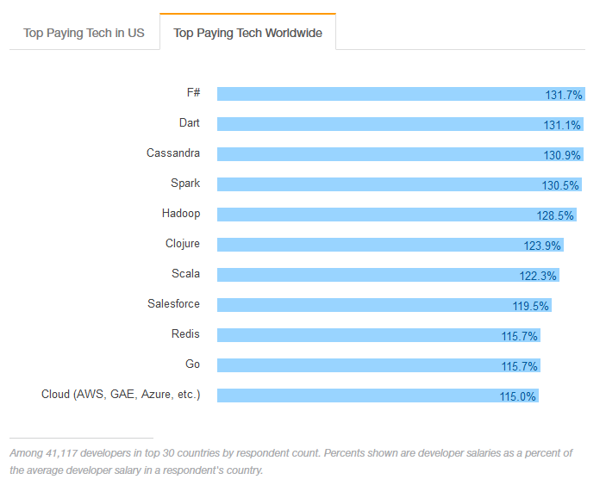
http://stackoverflow.com/research/developer-survey-2016#technology-top-paying-tech

Slide 44
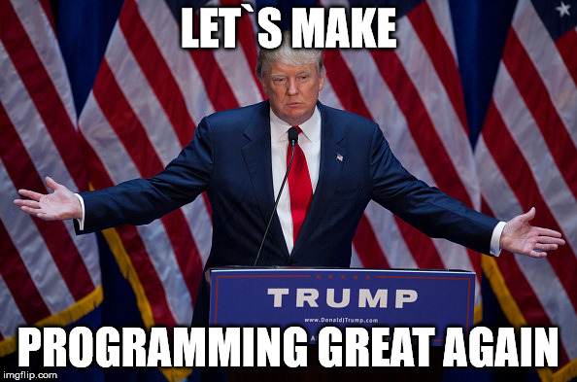

Slide 45
Let`s start with F#

Slide 46
.fs vs .fsx

Slide 47
module vs namespace

Slide 48

Babica rule

Slide 49

If you don`t know, use module

Slide 50

F# cool features

Slide 51
Functions

Slide 52
First-class citizen

Slide 53
Lambda (anonymous) functions support

Slide 54
Essential type for FP

Slide 55
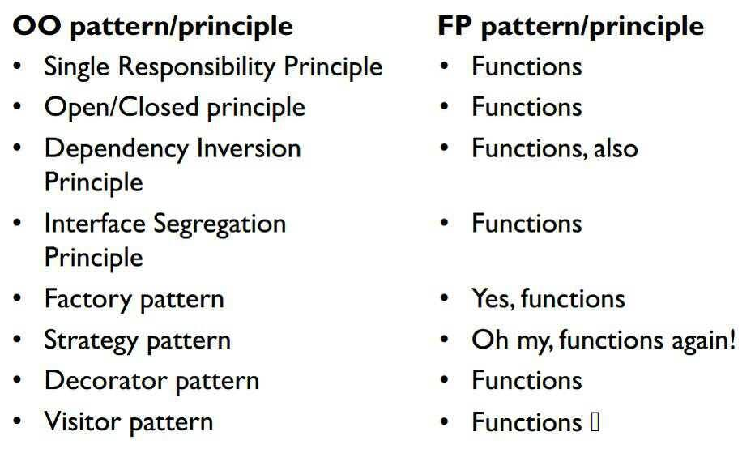
http://blog.cleancoder.com/uncle-bob/2014/11/24/FPvsOO.html

Slide 56
DEMO #1 Function

Slide 57
Tuple

Slide 58
Data structure with N elements

Slide 59
Ideal as lightweight function return value

Slide 60
("Answer to unknown question", 42)

Slide 61
DEMO #2 Tuples

Slide 62
Lists

Slide 63
F# list <> .NET List class

Slide 64
Immutable by default

Slide 65
Easy to work with

Slide 66
module Microsoft.FSharp.Collections.List

Slide 67
DEMO #3 Lists

Slide 68
Option

Slide 69
Do you remember NULL?

Slide 71
Use Option

Slide 72
Some(value)

Slide 73
None

Slide 74
Nothing else

Slide 76
DEMO #4 Options

Slide 77
Pattern Matching

Slide 78
Best. Thing. Ever.

Slide 79
SWITCH (on heavy drugs)

Slide 80
Is everywhere in F#

Slide 81
DEMO #5 Pattern Matching

Slide 82
Discriminated Unions

Slide 83
Another essential type

Slide 84
Pattern Matching Support

Slide 85
Enum (on even heavier drugs)

Slide 86
Value that can be exactly one case

Slide 87
DEMO #6 Discriminated Unions

Slide 88
Records

Slide 89
Great for grouping data into structured format

Slide 90
Immutable by default

Slide 91
But easy to clone

Slide 92
Cannot be inherited

Slide 93
Structural comparison and equality

Slide 94
Pattern Matching Support

Slide 95
“.” notation access

Slide 96
DEMO #7 Records

Slide 97
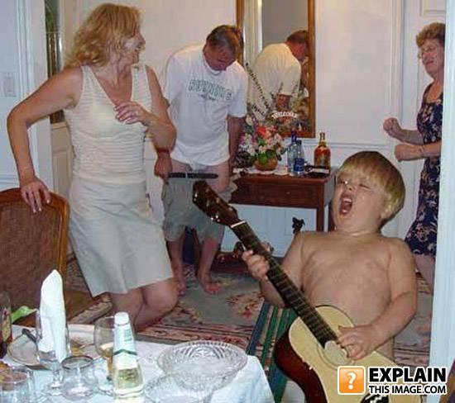
Even cooler features

Slide 98
Operators

Slide 99
|>

Slide 100
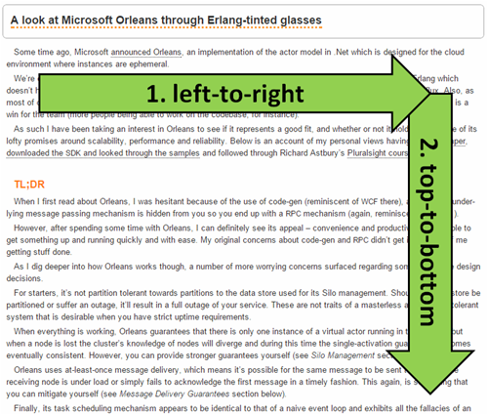
http://theburningmonk.com/2014/12/being-visually-honest-with-f/

Slide 101
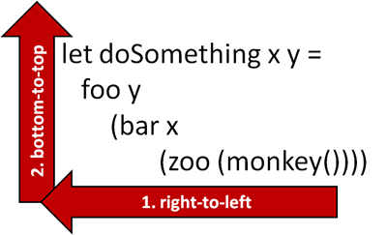
http://theburningmonk.com/2014/12/being-visually-honest-with-f/

Slide 102
|>

Slide 103
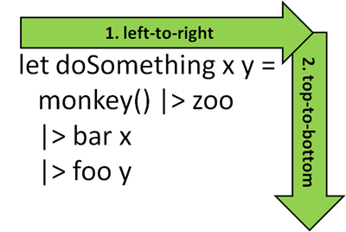
http://theburningmonk.com/2014/12/being-visually-honest-with-f/

Slide 104
<|

Slide 105
Function composition

Slide 106
>>

Slide 107
f(a) -> b >> f(b) -> c

Slide 108
f(a) -> c

Slide 109
<<

Slide 110
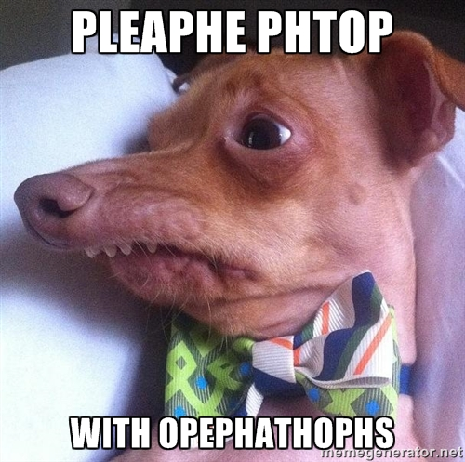

Slide 111
DEMO #8 Operators

Slide 112
Partial Function Application

Slide 113
Don`t use tuples as input parameters

Slide 114
Currying

Slide 115
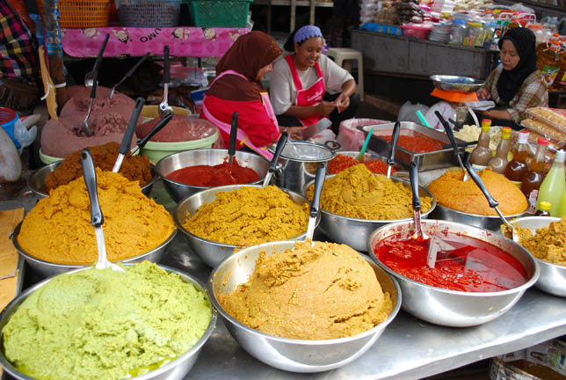

Slide 116
Transformation of function with N parameters into chain of N functions with 1 parameter

Slide 117
DEMO #9 Partial Function Application

Slide 118
Summary

Slide 119
F# is COOL!

Slide 120
Pattern Matching
Type inference
Immutability
Operators
Functions
Records
Discriminated Unions
no NULL

Slide 121
…and much more!

Slide 122
Thank you!

Slide 123
Please fill in
fsharping.cz/feedback
Úvod do světa F# (pohledem C# vývojáře)
Roman Provazník
@dzoukr
www.fsharping.cz
@fsharping

